Slide 1
Enhancing Communication through AI in Sign Language Translation
CS 5720: Neural Network & Deep Learning
TITLE :

Slide 2
Group Member Information
S.No | Name | ID
1. | Ahalya Reddy Choda | 700746558
2. | Kesara Chenna Praneeth Reddy | 700756460
3. | Prem Kumar Kamma | 700756204
4. | Venkatanaganikhil Reddy Sanikommu | 700746372

Slide 3
Responsibilities and Contribution in project
Ahalya Reddy Choda - Development of robust speech recognition algorithms capable of
accurately transcribing spoken language. Integration of natural language processing (NLP)
techniques to extract semantic meaning from transcribed speech.Utilization of computer vision
algorithms to generate sign language gestures corresponding to the transcribed speech.
Kesara Chenna Praneeth Reddy - Development of machine translation models capable of converting written text
into sign language glosses or descriptions. Integration of animation techniques to generate
lifelike sign language gestures from translated text. Incorporation of linguistic rules and cultural
considerations to ensure accurate and culturally appropriate translations.
Prem Kumar Kamma – The sign Language-to-Text/Speech Translation Module is to convert sign language
gestures into written text or spoken language. Development of computer vision algorithms for
accurate and robust sign language gesture recognition. Integration of natural language generation
(NLG) techniques to produce written text or synthesized speech from recognized gestures.
Venkatanaganikhil Reddy Sanikommu – Compile the project report according to the provided structure,
including sections such as Introduction, Methodology, Results, Discussion, and Conclusion. Adaptation
to diverse sign language dialects and variations to Ensure broad applicability. Accessibility features
such as text-to-speech synthesis for spoken language output .

Slide 4
Motivation :
Bridging the Communication Gap
Accessibility:
Traditional SLT methods have limitations in availability and access, especially in remote areas or for individuals with limited resources.
AI-powered solutions offer on-demand and remote accessibility, overcoming geographical barriers.
Efficiency and Speed:
AI systems can significantly speed up communication by automating the translation process.
Real-time translation capabilities are crucial in dynamic environments like meetings or emergency situations.
Scalability :
The demand for SLT services is increasing, and AI offers scalable solutions to address the shortage of qualified interpreters.
AI-driven systems can handle large volumes of translation requests efficiently.
Personalization:
AI algorithms can adapt to individual user preferences and learning styles, offering personalized feedback and recommendations.
This personalization improves user experience and learning outcomes.
Innovation:
Investing in AI-powered SLT drives advancements in assistive technology and accessibility research.
Integration with AR and wearable devices can further enhance communication experiences.

Slide 5
Objectives:
Building a Comprehensive Translation System
Speech-to-Sign Language Translation:
Develop accurate speech recognition algorithms to transcribe spoken language.
Utilize NLP techniques to understand the semantic meaning of the transcribed text.
Employ computer vision algorithms to generate corresponding sign language gestures.
Text-to-Sign Language Translation:
Develop machine translation models to convert written text into sign language glosses or descriptions.
Use animation techniques to create lifelike sign language gestures from translated text.
Incorporate linguistic rules and cultural considerations for accurate and appropriate translations.
Sign Language to Speech/Text Translation:
Develop robust computer vision algorithms for sign language gesture recognition.
Integrate natural language generation techniques to produce written text or synthesized speech.
Adapt to various sign language dialects and variations for broader applicability.
Include accessibility features like text-to-speech for spoken language output.

Slide 6
Problem Statement:
Overcoming Communication Barriers and Accessibility Gaps
Limited Accessibility of Traditional SLT Methods: Highlight the restricted access to qualified interpreters, especially in remote areas or for specific languages.
Inefficiency and Time Constraints: Emphasize the time-consuming nature of traditional translation methods, hindering real-time communication and responsiveness.
Scalability Issues: Address the challenges in meeting the growing demand for sign language translation services due to limited resources and interpreter availability.
Lack of Personalization: Point out the inability of traditional methods to adapt to individual learning styles and preferences, potentially hindering effective communication and learning outcomes.
Technological Gaps in Existing AI Solutions: Mention the limitations of current AI-driven solutions in terms of accuracy, inclusivity, and adaptability to diverse sign languages and signing styles.

Slide 7
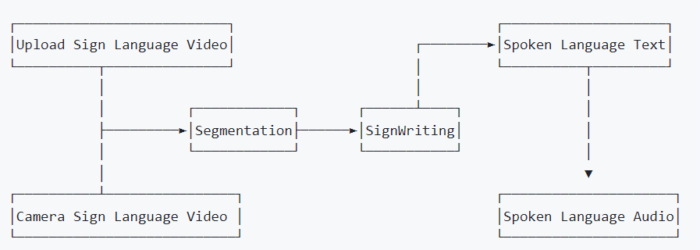
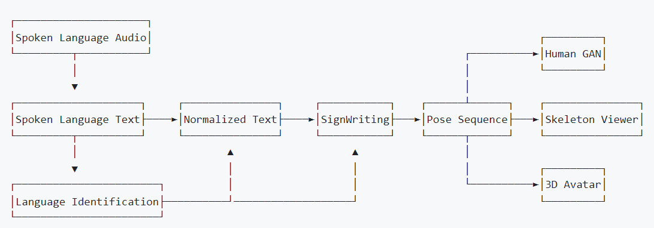
Related work:
Learning from Existing Research
Sign Language Detection:
Discuss existing approaches using CNNs and RNNs for detecting signing activity in video frames.
Highlight the need for well-annotated datasets with diverse scenarios.
Sign Language Identification:
Present research on identifying specific sign languages using visual features and machine learning models.
Emphasize the need for further development to distinguish between a wider range of sign languages.
Sign Language Segmentation:
Explain current segmentation methods and challenges due to the simultaneous nature of sign language gestures.
Stress the importance of understanding sign language structure for improved segmentation techniques.
Sign Language Recognition, Translation, and Production:
Discuss previous work on isolated sign recognition and continuous signing sequence recognition.
Highlight the advancements and limitations of existing sign language translation and production systems.

Slide 8
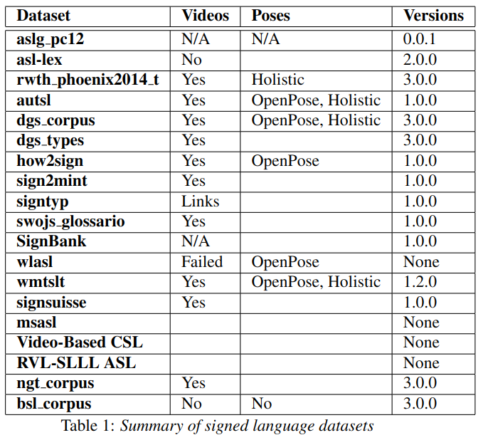
Opensourced Datasets :
Several publicly available datasets can be leveraged for training sign language translation models. Below are datasets selected to evaluate the models used in our project
Speech-to-Sign Language Translation
Text-to-Sign Language Translation
Sign Language-to-Text/Speech Translation

Slide 9
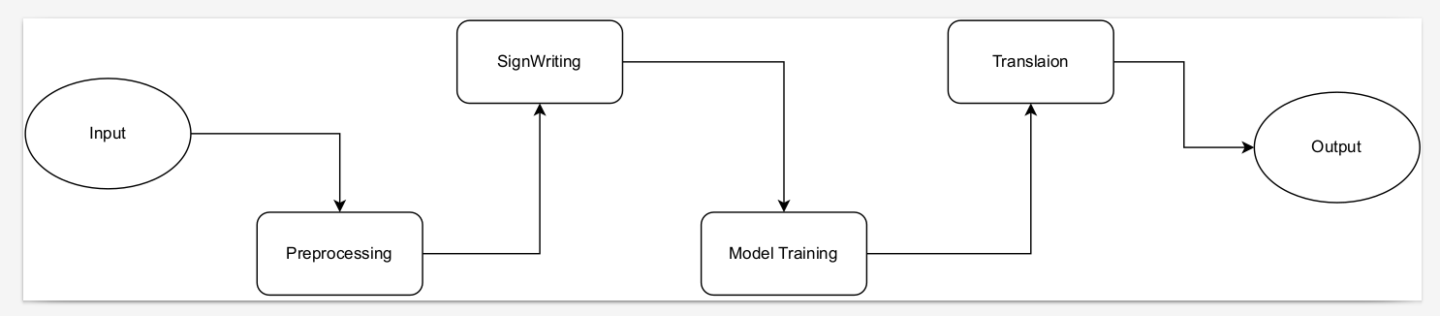
Proposed Solution:
Key Components:
Data Acquisition & Preprocessing: Briefly mention the use of relevant datasets and the process of preparing the data for training.
SignWriting Representation: Briefly explain the role of SignWriting as an intermediate representation for translation.
Machine Translation Models: Mention the use of neural machine translation models and their functionalities.
API Server: Briefly describe the development of an API server for practical application of the translation models.

Slide 10
Experimentation:
Bilingual ASL-to-English Translation :
Model: "baseline transformer spm factor sign+"
Dataset: SignBank
Framework: Joey NMT
Evaluation Metric: BLEU score
Results: BLEU score exceeding 30, indicating strong performance in translating ASL to English.
Comparison with Alternative Approaches:
1. Direct comparisons were challenging due to variations in data, evaluation methods, and methodologies.
2. The SignWriting-based approach appears competitive, potentially offering more accurate and nuanced translations compared to systems relying on glosses or other intermediate representations.

Slide 11
Simulations

Slide 12
References
[1] R. E. Johnson and S. K. Liddell, “Toward a phonetic representation of signs: Sequentiality and contrast,” Sign Language Studies, vol. 11, no. 2, pp. 241–274, 2011.
[2] W. Sandler, “The phonological organization of sign languages,” Language and linguistics compass, vol. 6, no. 3, pp. 162–182, 2012.
[3] D. Brentari and C. Padden, “A language with multiple origins: Native and foreign vocabulary in american sign language,” Foreign vocabulary in sign language: A cross-linguistic investigation of word formation, pp. 87–119, 2001.
[4] A. Moryoussef, “sign.mt: Effortless real-time sign language translation,” https://sign.mt/, 2023.
[5] M. Borg and K. P. Camilleri, “Sign language detection “in the wild” with recurrent neural networks,” in ICASSP 2019-2019 IEEE International Conference on Acoustics, Speech and Signal Processing (ICASSP). IEEE, 2019, pp. 1637–1641.
[6] A. Moryoussef, I. Tsochantaridis, R. Aharoni, S. Ebling, and S. Narayanan, “Real-time sign language detection using human pose estimation,” in Computer Vision–ECCV 2020 Workshops: Glasgow, UK, August 23–28, 2020, Proceedings, Part II 16. Springer, 2020, pp. 237–248.
[7] A. Pal, S. Huber, C. Chaabani, A. Manzotti, and O. Koller, “On the importance of signer overlap for sign language detection,” arXiv preprint arXiv:2303.10782, 2023.
[8] B. G. Gebre, P. Wittenburg, and T. Heskes, “Automatic sign language identification,” in 2013 IEEE International Conference on Image Processing. IEEE, 2013, pp. 2626–2630.
[9] C. D. Monteiro, C. M. Mathew, R. Gutierrez-Osuna, and F. Shipman, “Detecting and identifying sign languages through visual features,” in 2016 IEEE International Symposium on Multimedia (ISM). IEEE, 2016, pp. 287–290.
[10] D. McKee and G. Kennedy, “Lexical comparison of signs from american, australian, british and new zealand sign languages,” The signs of language revisited: An anthology to honor Ursula Bellugi and Edward Klima, vol. 20, no. 0, p. 0, 2000.
[11] P. Santemiz, O. Aran, M. Saraclar, and L. Akarun, “Automatic sign segmentation from continuous signing via multiple sequence alignment,” in 2009 IEEE 12th International Conference on Computer Vision Workshops, ICCV Workshops. IEEE, 2009, pp. 2001–2008.

Slide 13
References
[12] I. Farag and H. Brock, “Learning motion disfluencies for automatic sign language segmentation,” in ICASSP 2019-2019 IEEE International Conference on Acoustics, Speech and Signal Processing (ICASSP). IEEE, 2019, pp. 7360–7364.
[13] W. Sandler, “Prosody and syntax in sign languages,” Transactions of the philological society, vol. 108, no. 3, pp. 298–328, 2010.
[14] M. De Sisto, D. Shterionov, I. Murtagh, M. Vermeerbergen, and L. Leeson, “Defining meaningful units. challenges in sign segmentation and segment-meaning mapping,” https://aclanthology. org/volumes/2021. mtsummit-at4ssl/, pp. 98–103, 2021.
[15] A. Imashev, M. Mukushev, V. Kimmelman, and A. Sandygulova, “A dataset for linguistic understanding, visual evaluation, and recognition of sign languages: The k-rsl,” in Proceedings of the 24th Conference on Computational Natural Language Learning, 2020, pp. 631–640.
[16] O. M. Sincan and H. Y. Keles, “Autsl: A large scale multi-modal turkish sign language dataset and baseline methods,” IEEE access, vol. 8, pp. 181 340–181 355, 2020.
[17] R. Cui, H. Liu, and C. Zhang, “Recurrent convolutional neural networks for continuous sign language recognition by staged optimization,” in Proceedings of the IEEE conference on computer vision and pattern recognition, 2017, pp. 7361–7369.
[18] N. C. Camgoz, S. Hadfield, O. Koller, H. Ney, and R. Bowden, “Neural sign language translation,” in Proceedings of the IEEE conference on computer vision and pattern recognition, 2018, pp. 7784–7793.
[19] M. De Coster, D. Shterionov, M. Van Herreweghe, and J. Dambre, “Machine translation from signed to spoken languages: State of the art and challenges,” Universal Access in the Information Society, pp. 1–27, 2023.
[20] M. Muller, S. Ebling, E. Avramidis, A. Battisti, M. Berger, ¨ R. Bowden, A. Braffort, N. C. Camgoz, C. Espa ¨ na-Bonet, ˜ R. Grundkiewicz et al., “Findings of the first wmt shared task on sign language translation (wmt-slt22),” in Proceedings of the Seventh Conference on Machine Translation (WMT), 2022, pp. 744– 772.
[21] A. Moryoussef and Z. Jiang, “Signbank: Multilingual sign language translation dataset,” arXiv preprint arXiv:2309.11566, 2023.

